Slide 1

Black Friday Sales Prediction using AI/ML
22015641 - Abiral Pradhanang

Slide 2

INTRODUCTION

Slide 3
INTRODUCTION
Black Friday, known for its substantial discounts and best deals, introduces unpredictable consumer demands, leading to varying sales volumes that crucially impact a company's profitability. Black Friday sales prediction involves analytical methods and forecasting techniques to estimate product or service performance during this high-demand shopping event. Specifically tailored prediction models prove highly beneficial during this time, as customer spending differs significantly from a typical day due to the allure of discounts and price reductions. This prediction process includes analyzing historical sales data and considering factors such as consumer behavior, economic conditions, and market trends to anticipate demand for specific products or categories.

Slide 4
Problem Domain
In the current scenario, predicting Black Friday sales faces challenges due to the dynamic nature of various factors. Changes in people's behaviors, influenced by major events, economic fluctuations, or health issues, contribute to the unpredictability of consumer spending patterns. The increasing trend of online shopping adds complexity, making it challenging to anticipate how consumers will shop compared to traditional in-store visits. The abundance of information available requires thorough analysis, and finding the crucial insights becomes a daunting task. Moreover, the intense competition among stores during Black Friday, with each employing various strategies to attract customers, creates a tough and competitive environment.

Slide 5
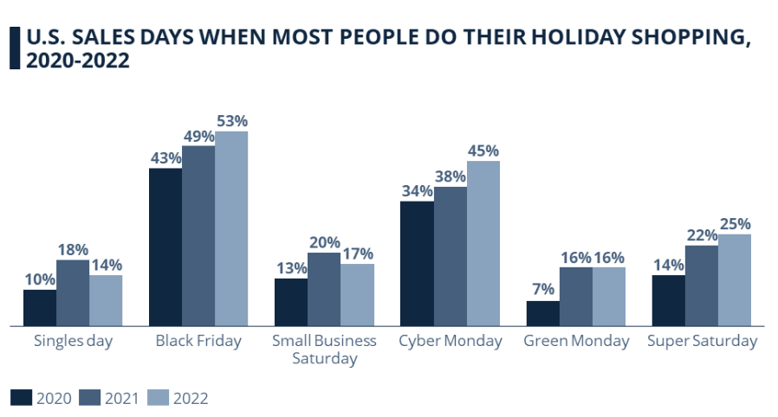
Problem Domain
Bar-graph showing sales on various occasions for shopping

Slide 6
Project Scope
Black Friday, as the pinnacle of annual shopping events with consistently increasing sales, presents challenges for sellers in managing manufacturing supply chains and meeting customer demands. The integration of advanced analytics powered by AI becomes crucial due to the complexity and abundance of data generated during Black Friday. By utilizing machine learning models, specifically Linear Regression, Random Forest Regression, and Decision Trees, to enhance sales prediction capabilities. These models excel at recognizing intricate patterns in historical sales data, customer behavior, and external factors influencing purchasing decisions. Through predictive modeling, these ML algorithms forecast consumer demand, identify optimal pricing strategies, and optimize inventory management. The project's outcome is a more accurate and responsive sales prediction model that empowers retailers to anticipate and capitalize on the dynamic nature of Black Friday.

Slide 7
Advantages of Sales Prediction
Enhanced Accuracy: ML algorithms can analyze vast amounts of data, including historical sales, customer behavior, and market trends, leading to more accurate predictions for Black Friday sales.
Personalized Marketing: AI-driven insights enable personalized marketing strategies, customized promotions, and recommendations to individual customer preferences, increasing the chances for more sales.
Quick Decision-making: With the ability to process and analyze data rapidly, AI allows retailers to make informed and quick decisions on pricing, promotions, and inventory adjustments during the fast-paced Black Friday event. iv. Strategic Planning: AI insights provide retailers with a strategic advantage by helping them plan marketing campaigns, allocate resources, and set competitive prices based on data-driven predictions.

Slide 8
Disadvantages of Sales Prediction
Dependency on existing data: Artificial intelligence is only constrained by data accessibility. Since there is a direct correlation between the quality of data and the capabilities of an AI application, data becomes the key to an AI system. Therefore, the effectiveness of artificial intelligence is constrained by the absence of precise data and limits the adaptability to Black Friday events.
Data Reliability: Effective AI predictions rely heavily on high-quality, relevant data. Inaccurate or biased data can lead to flawed predictions and impact the overall success of Black Friday sales strategies.
Limited Understanding: Retailers and decision-makers may lack a comprehensive understanding of AI, leading to potential misinterpretation or distrust in the predictions provided by the system.

Slide 9
Datasets
Variable | Definition | Data Type
User_ID | Unique User id | Int64
Product_ID | Unique Product id | Object
Gender | Sex of the user | Object
Age | Age in bins (or Age in range) | Object
Occupation | Occupation (Masked) | Int64
City_Category | Category of the city (A, B, C) | Object
Stay_In_Current_City_Years | Number of years staying in current city | Object
Marital_Status | Marital Status | Int64
Product_Category_1 | Product Category (Masked) | Int64
Product_Category_2 | Product may also belong to another category (Masked) | Float64
Product_Category_3 | Product may also belong to another category (Masked) | Float64
Purchase | Purchase Amount (Target variable) | Int64

Slide 10
SELECTED ALGORITHMS
Linear Regression
Decision Tree
Random Forest
Predicts a dependent variable (y) based on a given independent variable (x), showcasing a linear relationship between the two
constructs a tree-shaped structure for regression or classification purposes, breaking down the dataset into smaller subsets
Enhance predictive accuracy by averaging the predictions from each tree.

Slide 11
Development Process

Slide 12
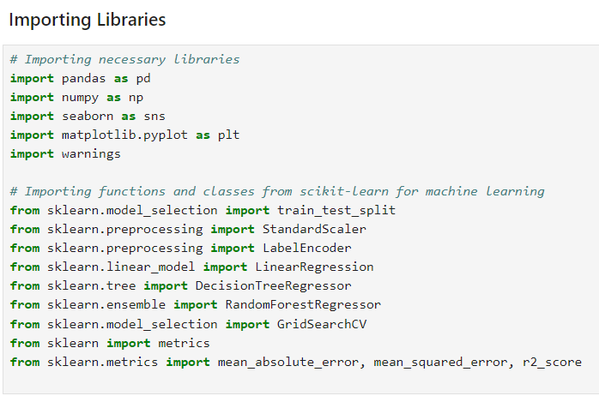
Importing Libraries

Slide 13
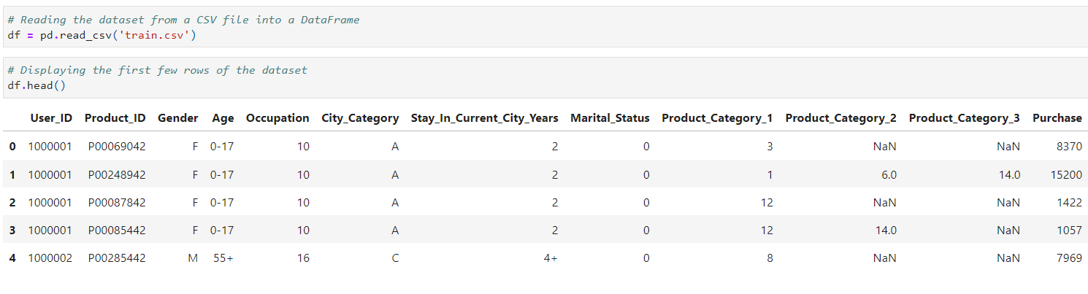
Loading Dataset

Slide 14
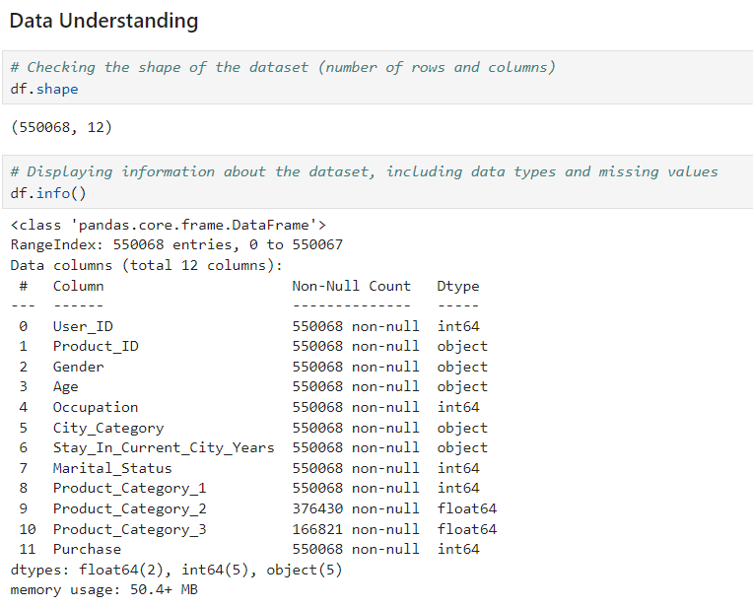
Displaying shape of the dataset

Slide 15
Displaying Data type

Slide 16
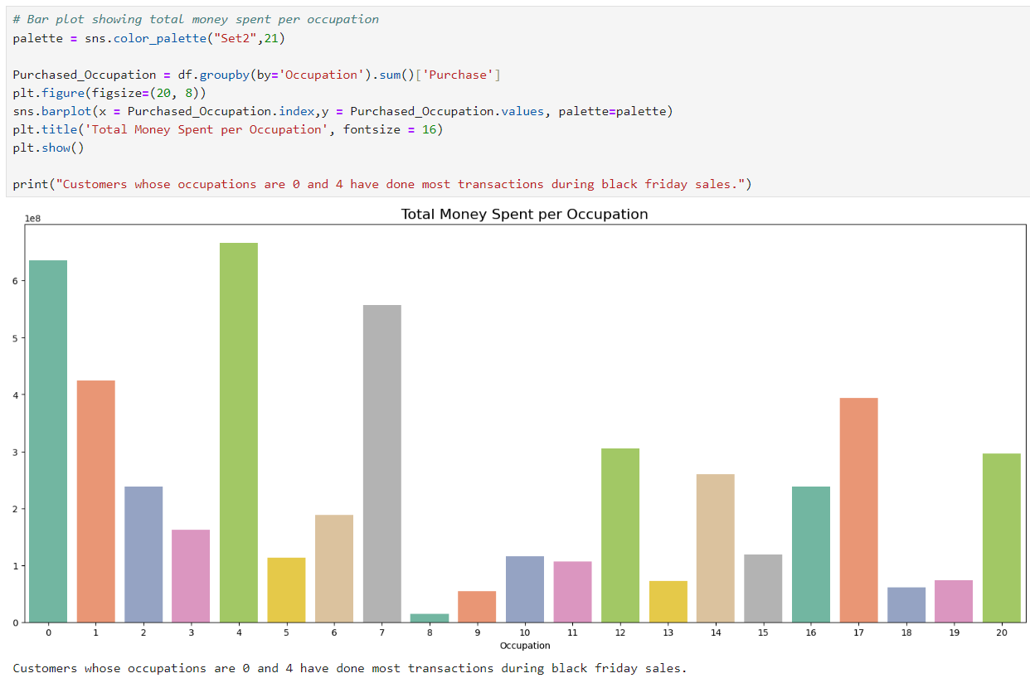
Data Visualization

Slide 17
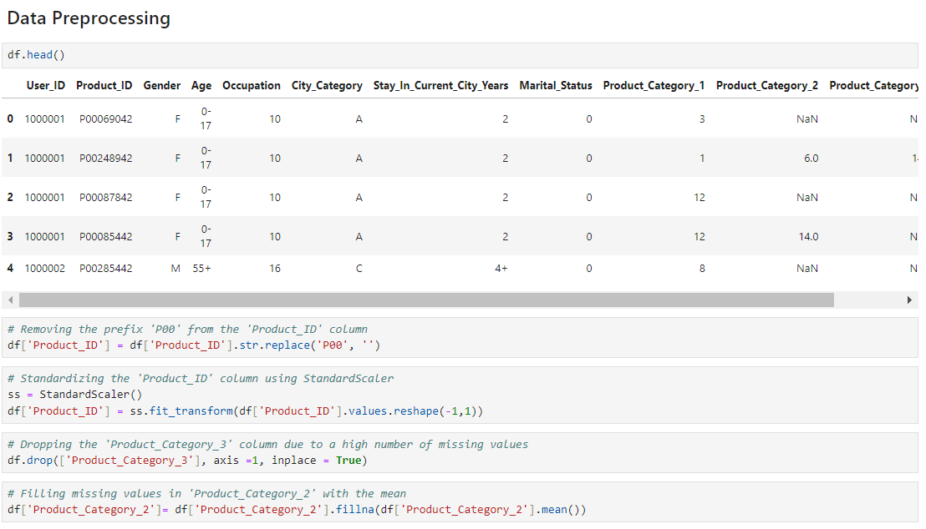
Data Preprocessing

Slide 18
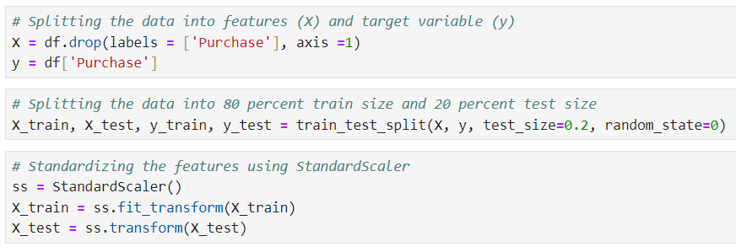
Splitting Data

Slide 19
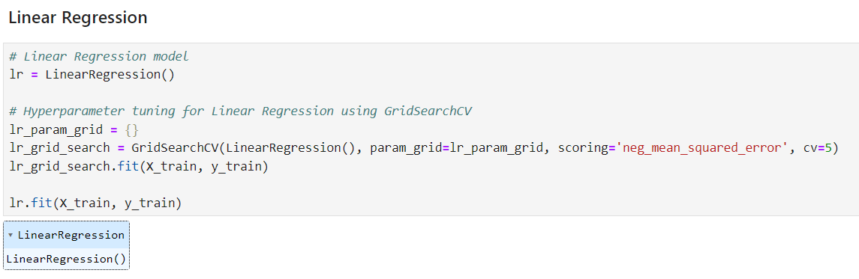
Linear Regression Model

Slide 20
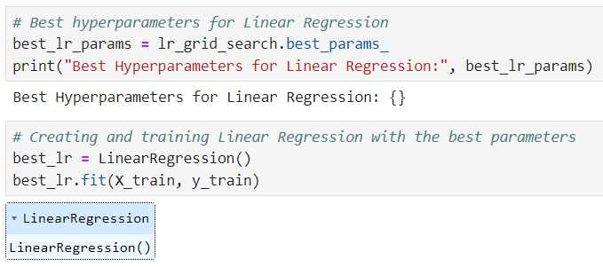
Linear Regression Model

Slide 21
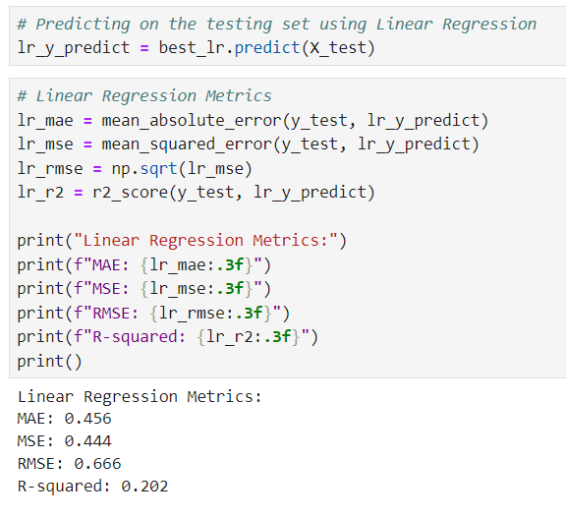
Linear Regression Model

Slide 22
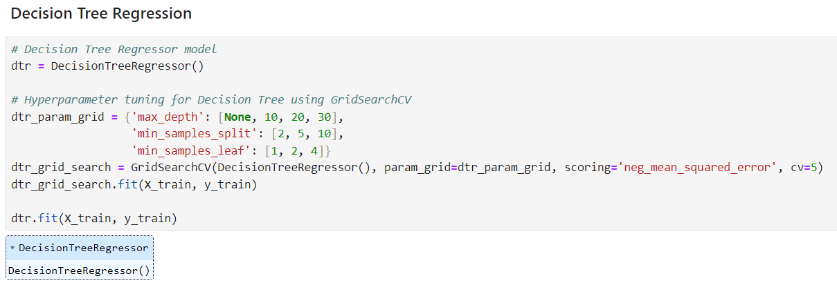
Decision Tree Model

Slide 23
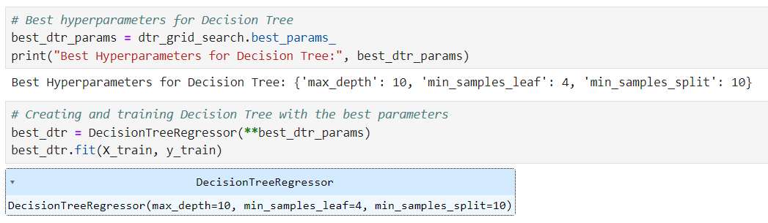
Decision Tree Model

Slide 24
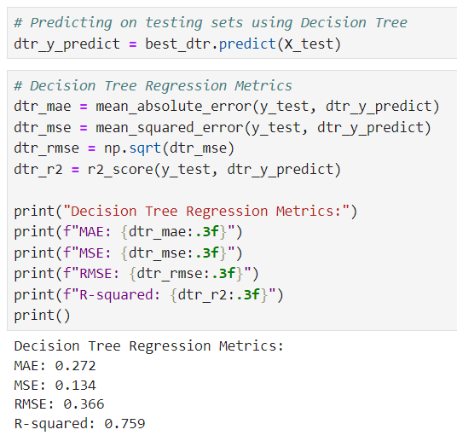
Decision Tree Model

Slide 25
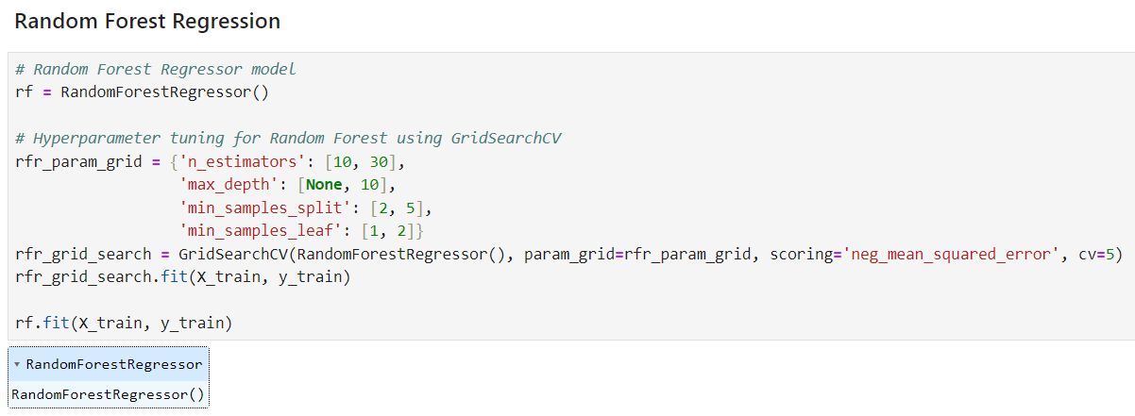
Random Forest Model

Slide 26
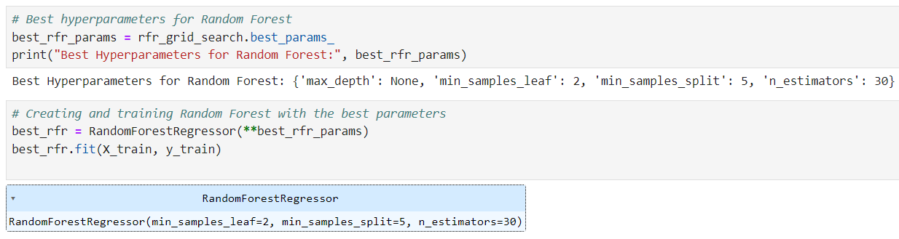
Random Forest Model

Slide 27
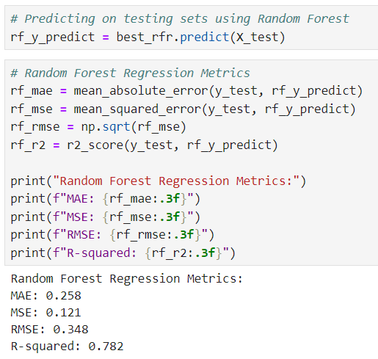
Random Forest Model

Slide 28
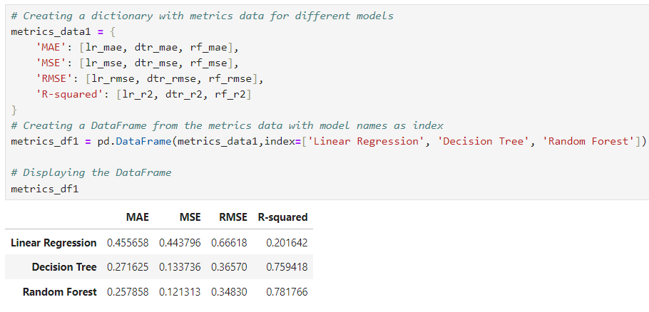
Regression Evaluating Metrics

Slide 29
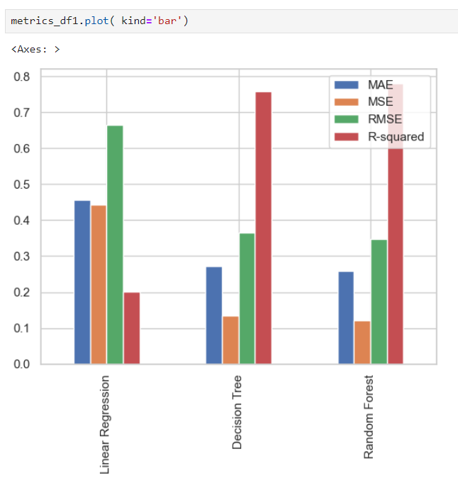
Regression Evaluating Metrics

Slide 30
Conclusion
The project involved a thorough analysis of the dynamics of Black Friday in the retail industry, addressing the challenges posed by the high demand for discounted products. Leveraging machine learning algorithms, including Linear Regression, Random Forest, and Decision Tree, the study aimed to optimize sales and profits for retailers. The use of Mean Squared Error (MSE) as a performance metric provided valuable insights into the predictive models' accuracy. The project successfully tackled the complexity of customer behavior analysis and sales forecasting during Black Friday, contributing to the broader discourse on retail management and predictive analytics.

